Slide 1
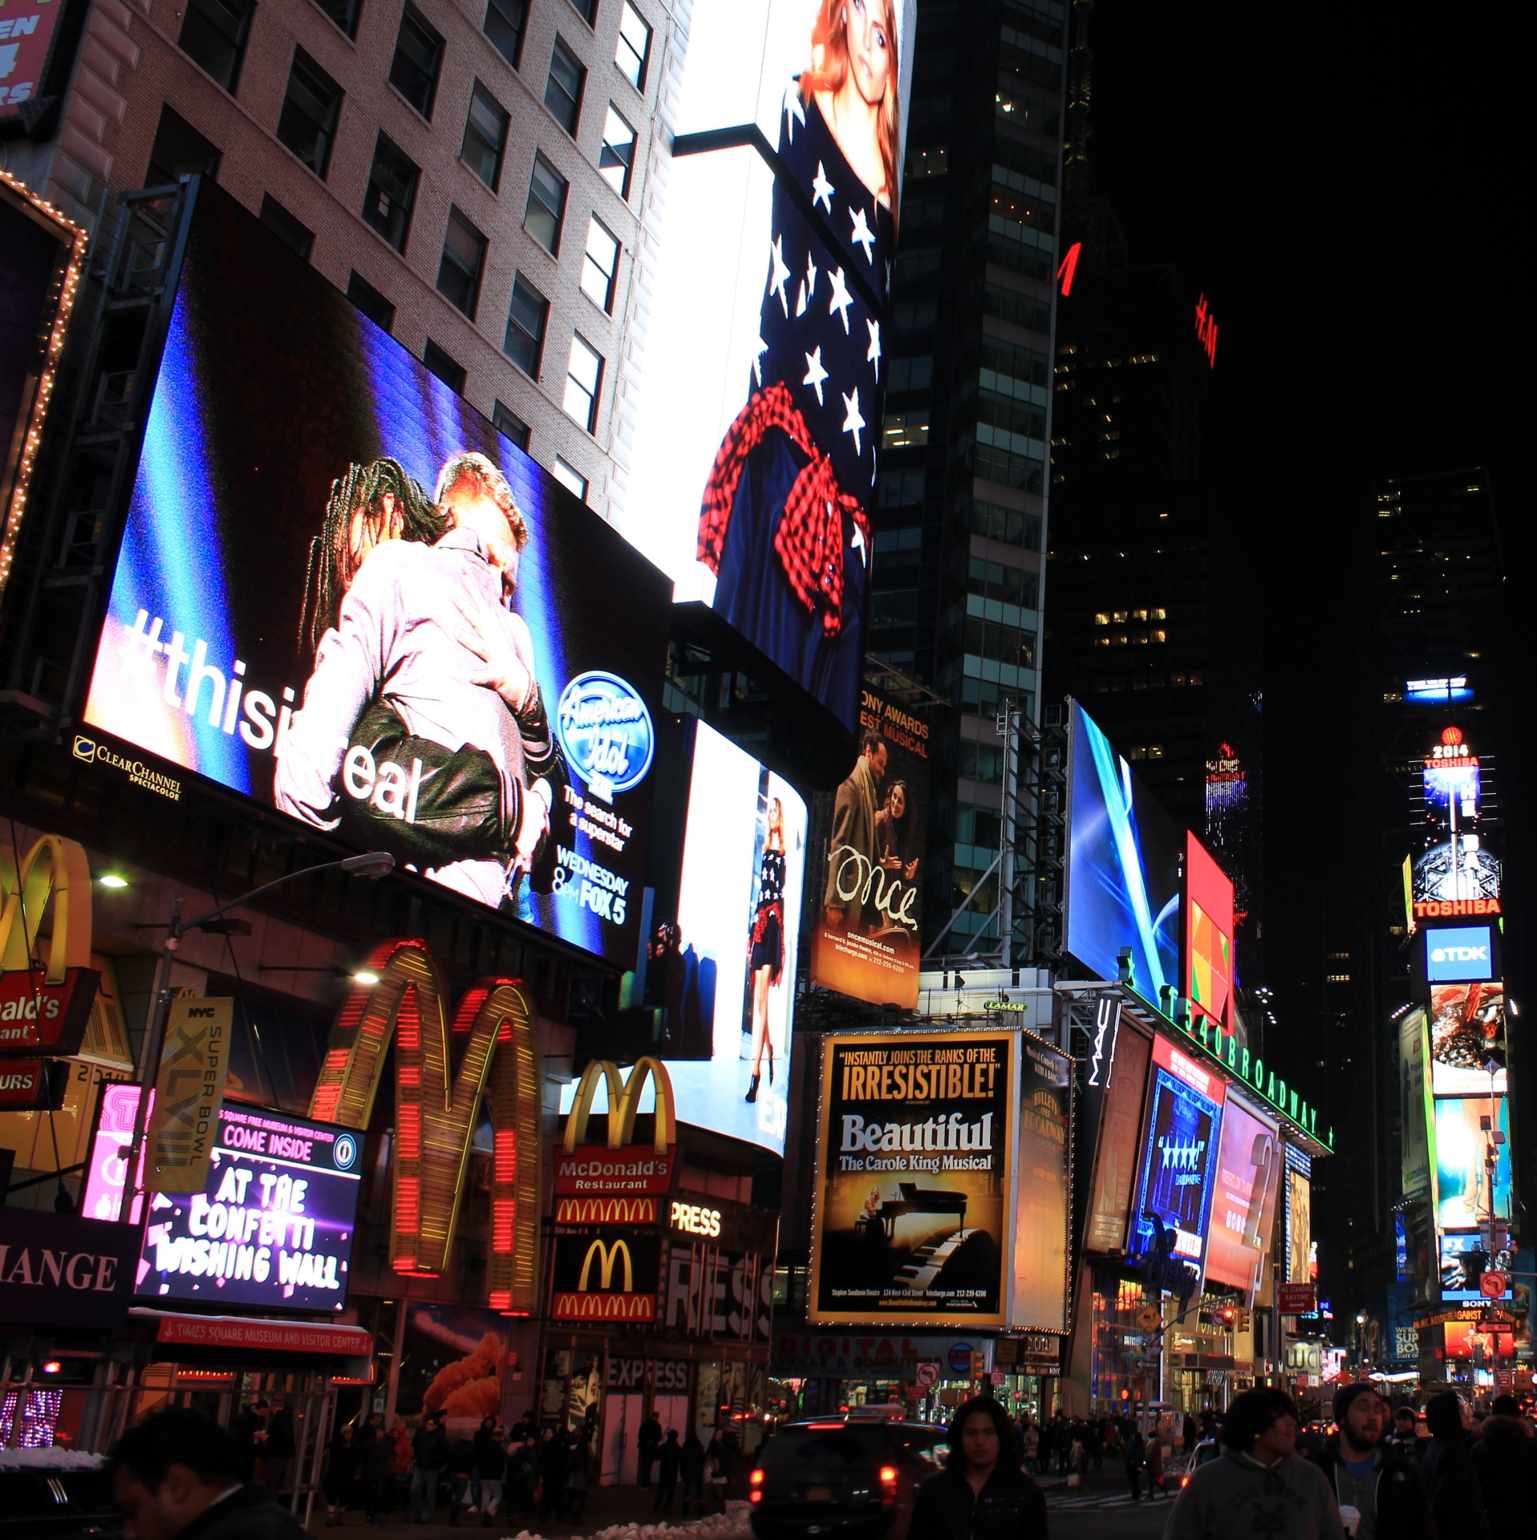
RETAIL & MARKETING Group 6
21st March 2017
Dinan Amiendiartha
Lara Al Daoud
Salkha Baraba
Johannes Barth
Akos Furton
Steven Locorotondo

Slide 2
THE DATA NURTURED APPROACH (DNA)
Agenda
Executive Summary
Market Overview
Advertising Mix
Framework
Statistical Methodology
High Level Results
Deep Dive Results
Recommendation

Slide 3
EXECUTIVE SUMMARY
Current advertising mix needs to be adjusted to achieve maximum impact on sales
Advertising mix based on a conscious set of decisions regarding target group, objective and strategy application
Longer advertisements in television considered more brand focused
Client aims for Retention, Acquisition or Upselling
Advertising mix centrally managed independent of individual stores
All variables are treated under the “same store” assumption
Assumptions
Sales as a function of visits and revenue per visit
Decomposed model
Determines the impact of television ads on visits and revenue per visit
Provides analysis on effectiveness of format given a certain target audience (Acquisition, Retention & Upselling)
Allows for reinvestment in profitable advertisement formats
Model
Longer ads boost visits and shorter ads drive extra purchases
15 seconds and 20 seconds TV ads increase purchase amount per visit
45 seconds ads placement determine changes in visits
More efficient budget allocation by using the optimal format and media
Further experiments to better capture the impact of each ad campaign
Results

Slide 4
MARKET OVERVIEW
14 companies compete in a slow growth and competitive market with a total volume of €2.5bn
Market share of competition accounting for 80% of market (2011 – 2015)
2011
2015
Concentrated market with 7 players dominating ~80% of the market
Source: Mintel Fast Food & Takeaways – Italy 2016

Slide 5
MARKET OVERVIEW
14 companies compete in a slow growth and competitive market with a total volume of €2.5bn
Compound annual growth rate (2011-2015)
3 competitors grew faster than the market
Source: Mintel Fast Food & Takeaways – Italy 2016

Slide 6
MARKET OVERVIEW
14 companies compete in a slow growth and competitive market with a total volume of €2.5bn
Market share development (2011 – 2015)
4 lost market share to faster growing competitors
Source: Mintel Fast Food & Takeaways – Italy 2016

Slide 7
DESCRIPTIVE ADVERTISING MIX
Overall advertisement budget decreased and is more focused compared to previous periods
Investment
5 communication channels
TV, Radio, Internet, Print & Special
Overall reduction in advertisement expenditures of 4.7%
143 Networks
14 Radio Broadcast
 | Day of ad | 10 days later | 20 days later | 30 days later
Internet | 94% | 54% | 29% | 16%
Print | 78% | 8% | 1% | 0%
Radio | 94% | 54% | 29% | 16%
Special | 86% | 22% | 5% | 1%
TV | 96% | 66% | 44% | 29%
The average customer spends € 7.38 per visit
Visits
grew by 49% to € 110mn in 2016

Slide 8
FRAMEWORK
Advertisement mix is based on conscious decisions and an objective driven approach
I
Considerations
Target
Audience demographic
New vs existing customer
Objective
Retention
Acquisition
Product Launch
Strategy
Advertise products or promotions
Brand awareness
Notes:
Log(sales) and log(visits)

Slide 9
FRAMEWORK
Advertisement mix is based on conscious decisions and an objective driven approach
I
Considerations
II
Promotion Channel
Target
Audience demographic
New vs existing customer
Objective
Retention
Acquisition
Product Launch
Strategy
Advertise products or promotions
Brand awareness
Select appropriate promotion channel
Television
Radio
Print
Internet
Notes:
Log(sales) and log(visits)

Slide 10
FRAMEWORK
Advertisement mix is based on conscious decisions and an objective driven approach
I
Considerations
II
Promotion Channel
III
Promotion Mix
Target
Audience demographic
New vs existing customer
Objective
Retention
Acquisition
Product Launch
Strategy
Advertise products or promotions
Brand awareness
Select appropriate promotion channel
Promotion
Short ads
Focused channels
Television
Short term impact
Radio
Product
Medium length ads
Wider use of channels
Print
Short term impact
Brand
Long ads
Internet
Focused use of channels
Long term impact
Notes:
Log(sales) and log(visits)

Slide 11
FRAMEWORK
Advertisement mix is based on conscious decisions and an objective driven approach
I
Considerations
II
Promotion Channel
III
Promotion Mix
IV
Ultimate Objective
Target
Audience demographic
New vs existing customer
Objective
Retention
Acquisition
Product Launch
Strategy
Advertise products or promotions
Brand awareness
Select appropriate promotion channel
Promotion
Short ads
Acquisition
Focused channels
Television
Short term impact
Radio
Product
Medium length ads
Retention
Wider use of channels
Print
Short term impact
Brand
Long ads
Up & Cross selling
Internet
Focused use of channels
Long term impact
Notes:
Log(sales) and log(visits)

Slide 12
STATISTICAL MODEL
Methodology to determine campaign effectiveness
I
Manipulation and Cleaning
II
Models
III
Analysis
Dates and time
Aggregate sales and investment by day
Calculate transaction amounts
Replace ‘gift’ campaigns with market value
Add adstock variables
Separate advertisements into air time
Derive ‘forgetfulness rate’ to best match the sales patterns
Define controlled factors
Linear regression models with different functional forms
Impact matrix
Cost-benefit analysis
Notes:
Log(sales) and log(visits)

Slide 13
HIGH LEVEL RESULT
Television has the biggest overall impact among the different channels
Sales
Number of visits
Purchase amount per visit
Overall
I
II
III
IV
V
Special
Television
Radio
Internet
Print
Notes:
Log(sales) and log(visits)

Slide 14
DEEP DIVE RESULTS
Medium length and long ads positively impact purchases and number of visits respectively
I
II
III
Impact on Purchase per Visit
Impact on Sales
Impact on Visits

Slide 15
DEEP DIVE RESULTS
daytime
Multiple formats deliver questionable returns on investment
Impact on Purchase per Visit
Positive
daytime
morning
primetime
morning
primetime
primetime
morning
primetime
Impact on Visits
Negative
Positive
night
daytime
Negative

Slide 16
RECOMMENDATION
Three step approach
primetime
Cut inefficient promotions
I
Impact on Visits
Negative
Cut all investments in formats that deliver questionable value
Insignificant or negative values on the regressed variables
night
night
daytime
daytime
daytime
Negative
Impact on Purchase per Visit

Slide 17
RECOMMENDATION
Three step approach
primetime
Cut inefficient promotions
I
Impact on Visits
Negative
Cut all investments in formats that deliver questionable value
Insignificant or negative values on the regressed variables
night
night
daytime
daytime
Reinvest free cash flows
II
Unleashed resources should be reinvested in campaigns that deliver real impact
Some formats serve as a “hygiene” factor and should be continued
daytime
Negative
Impact on Purchase per Visit

Slide 18
RECOMMENDATION
Three step approach
primetime
Cut inefficient promotions
I
Impact on Visits
Negative
Cut all investments in formats that deliver questionable value
Insignificant or negative values on the regressed variables
night
night
daytime
daytime
Reinvest free cash flows
II
Unleashed resources should be reinvested in campaigns that deliver real impact
Some formats serve as a “hygiene” factor and should be continued
daytime
Measure Impact
III
Focusing the efforts in the identified formats enables to measure and compare impacts
Readjustment of strategy after a certain waiting period
Negative
Impact on Purchase per Visit

Slide 19
THANK YOU
Questions?

